Slide 1

“JOB SEARCH APPLICATION”
Task - 3

Slide 2

Job Search Application
A Job Portal application is a place where users can search and apply for job openings. In the same application, the recruiters can post job details and seek applicants. The app is quite beneficial for both applicants and recruiters.
au910020104003 |  | CC2
au910020104044 |  | CC2
 |  | CC2
LMS Username
Name
Batch
AJITH KUMAR K
SUBHASRI M
au910020104304
GANESH KUMAR C

Slide 3

Task-3
Evaluation Metric:
User Interface (UI) Design:
Evaluate the overall design, layout, and visual appeal.
React Component Structure:
Assess the organization and structure of React components.
Check for the proper use of state and props.
Accessibility:
Evaluate the webapp for accessibility standards, ensuring it is usable by people with disabilities.
Job Details Page:
Check the completeness and accuracy of information on the job details page.
Ensure that the application process is clear and user-friendly.
User Authentication and Authorization:
Test the security of user authentication and authorization mechanisms.
Ensure that user data is protected.
Mobile Responsiveness:
Use mobile emulators and real devices to test the app's performance on various smartphones and tablets.

Slide 4
Step-Wise Description
Project Setup:
Create a new React.js project using Create React App or your preferred method.
Design the UI:
Create a design mockup using a tool like Figma
Create React Components:
Implement React components for each part of the UI. Break down the design into smaller components like headers, footers, job cards, and search bars.
Navigation:
Set up navigation between different sections using React Router.
Define routes for key pages like the home page, job listings, and job details.
Implement navigation links and ensure a smooth transition between pages.
Style with CSS:
Ensure a responsive design with media queries to accommodate various screen sizes.
Integrate with API:
Connect to a job listing API (e.g., GitHub Jobs API, Indeed API) using AJAX or Fetch
Search Functionality:
Implement a search feature to filter job listings. Allow users to search by keywords, location, and other relevant criteria.

Slide 5
Project Summary
The Job Search Portal is a comprehensive online platform designed to streamline and enhance the job search process for both job seekers and employers. This web-based application aims to connect talented professionals with relevant job opportunities while providing employers with efficient tools to find the best candidates for their vacancies.
customizable reports to help employers understand the effectiveness of their job postings and recruitment strategies.
Integration of community features, such as forums and networking events, to foster connections among professionals within specific industries.The Job Search Portal aims to revolutionize the job search landscape by providing a user-centric and technologically advanced platform, ultimately bridging the gap between job seekers and employers in a dynamic and competitive job market.

Slide 6
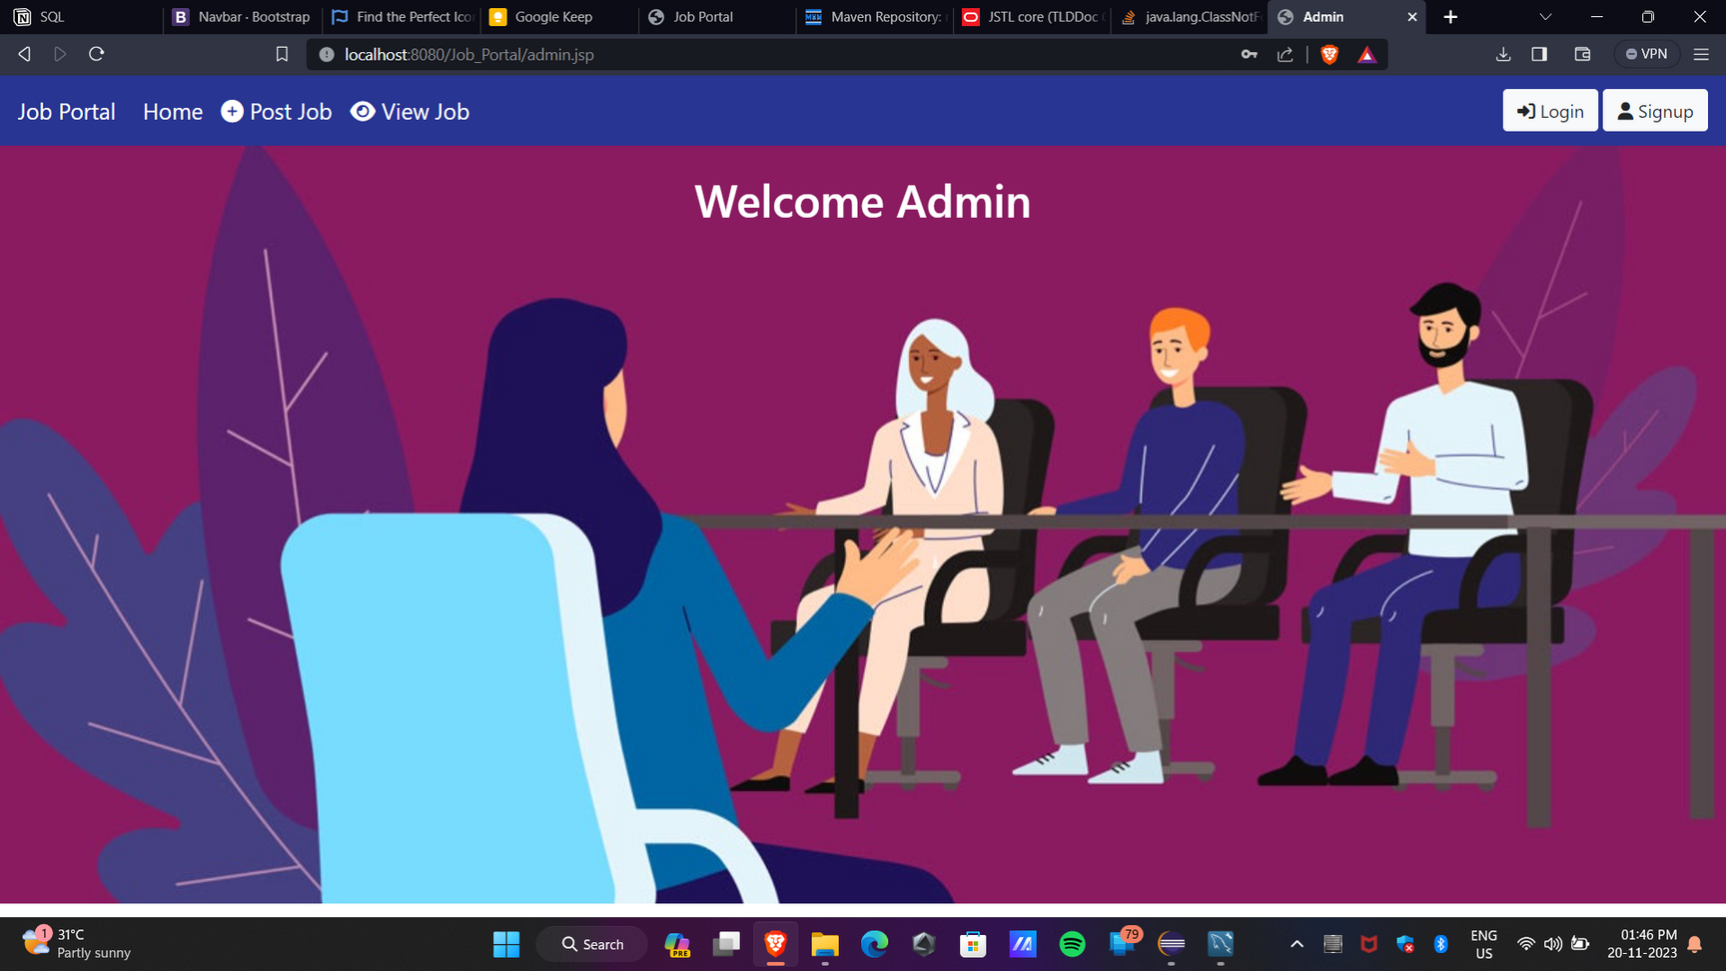
FRONTEND
.

Slide 7
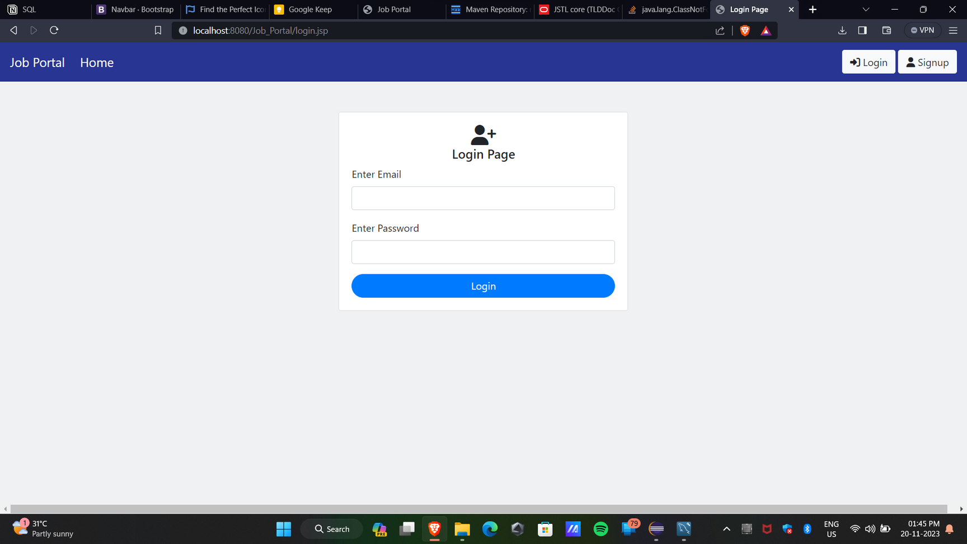
FRONTEND
.

Slide 8
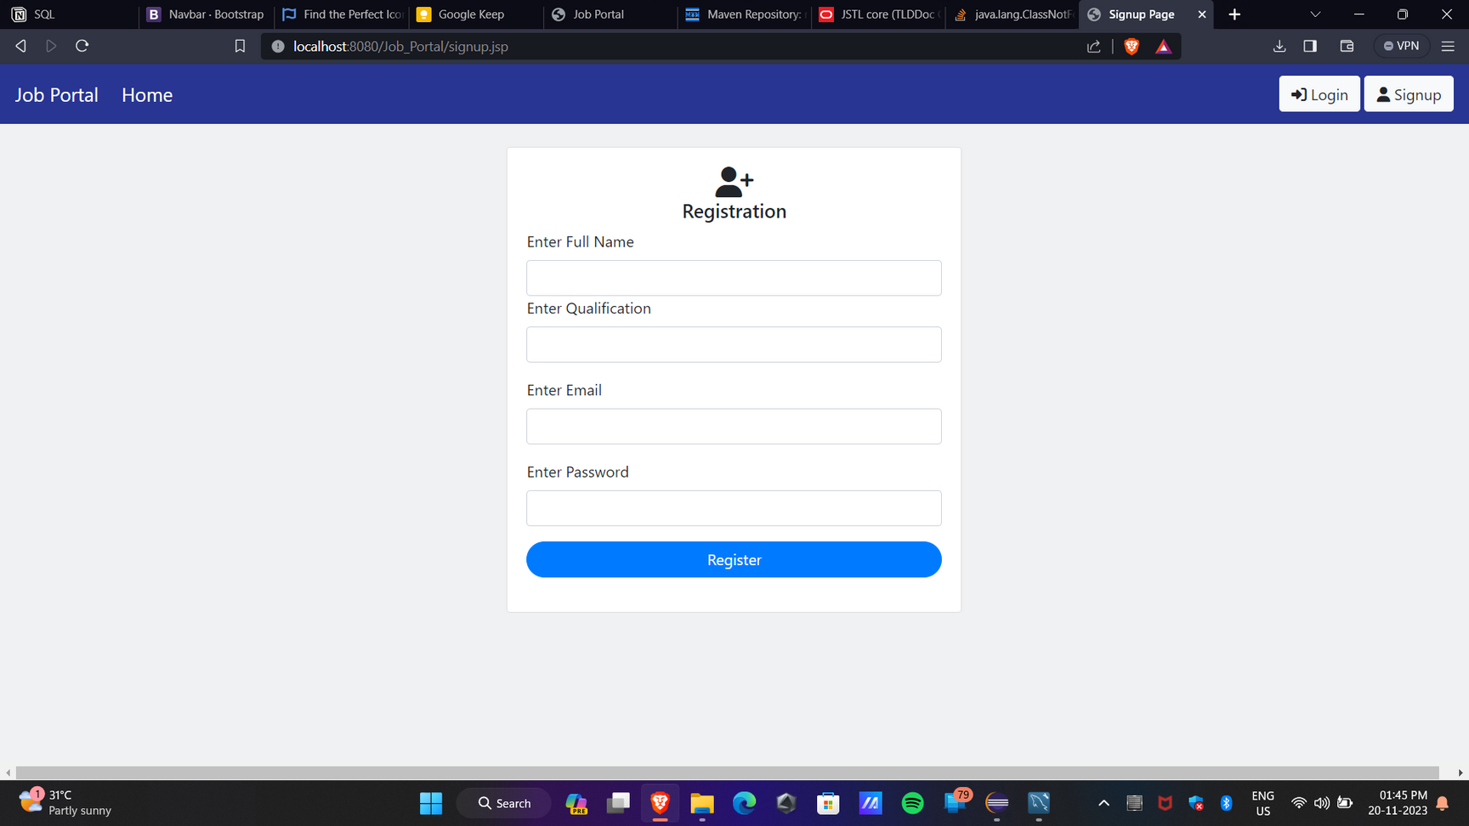
FRONTEND
.

Slide 9

Submission Github
https://github.com/ajithakdev/Jobsearch-App.git

Slide 10


